Slide 1

Dr. Brenda C. Snipes Broward County Supervisor of Elections
...WITH CONFIDENCE !
Elections Presentation
2014
Notes:
9am start

Slide 2
Election Process:
Voter Education and Outreach
Voter Registration
Candidate Qualifying
Voter Services
Election Day Operations
Election Planning and Development
Information Technology
Voting Equipment Center Operations

Slide 3
Latest Election Statistics
Current Statistics as of September, 2014
Democrats........................................541,822
Republicans......................................235,223
Others..............................................282,224
Total..............................................1,059,269
Voter Turnout
January 29, 2008......38.33% March 9, 2010………..9.04%
August 26, 2008.......11.41% August 24, 2010……14.93%
November 4, 2008....73.34% November 2, 2010…40.99%
January 31, 2012....21.21%
August 14, 2012......10.70%
November 6, 2012...66.85%

Slide 4
2010 ELECTION DATES 2014 Election Dates November 4, 2014 General Election

Slide 5
Voter I.D. Requirements
Florida driver’s license
Florida identification card issued by the Department of Highway Safety and Motor Vehicles
United States passport
Debit or credit card
Military identification
Student identification
Retirement center identification
Neighborhood association identification
Public assistance identification

Slide 6
2014 EARLY VOTING
November 4, 2014 General Election:
October 20, 2014 through November 2, 2014
Monday-Friday 9:00 a.m. to 7:00 p.m.
Saturday-Sunday 7:00 a.m. to 3:00 p.m.

Slide 7
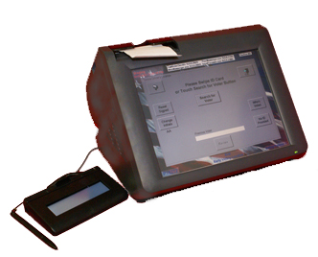
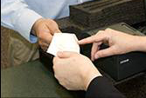
Election Day Check In
EViD
All-In-One
Serves as a check and balance to the voting process.
Provides a complete paper trail for every step of the voter check-in process.
Speeds up the voter check-in process, and voting experience as a whole.
Easy-to-read touch screen keyboard
Signature capture pad
Magnetic stripe reader to read Florida driver licenses

Slide 8
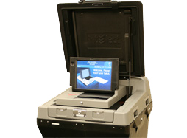
Current Voting Process
Vote in privacy booth using writing utensil provided.
The voter will insert the ballot into the DS 200 optical scanning machine.

Slide 9
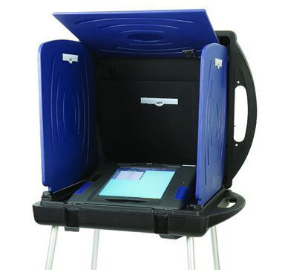
Two Ways to Vote on Election Day for the 2014 Elections
Paper Ballot
Touchscreen
or
DS 200 Scanner
ADA Compatible
iVotronic

Slide 10
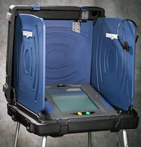
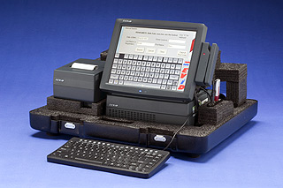
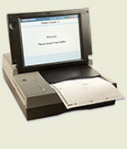
Touchscreen Voting for ADA Voters
Thank You
for Voting
Step 2 B
Step 1
Sign In
EViD Machine
Step 2 A
Step 3
Thank You
for Voting
Paper Ballot
Optical Scan
(must complete in
privacy booth)
(voter will
scan ballot)

Slide 11
Election Day Operations
Polling Places (FL Statutes 101.715) 577 Precincts
Election Day Workers (FL Statute 102.012)
Clerk ($200) Voting System Techs ($200)
Assistant Clerk ($170) Field VST Super Clerks ($200 + mileage)
Poll Deputy ($160) Bilingual / Inspectors ($165)
Training of Election Day Workers (FL Statute 102.014)
Poll Worker Recruitment
Hispanic and Creole speaking poll workers needed
Notes:
10:25
10 minutes

Slide 12
Absentee Ballot
Who’s eligible?
All Broward County registered voters
How to request an absentee ballot
954-357-7055, 24 hours a day, 7 days a week
Deadline to request an absentee ballot
Wednesday prior to an election
Absentee Ballot Rejected For:
1. No signature
2. Late return
All ballots need to be returned to the Supervisor of Elections office by 7:00 p.m. on Election Day

Slide 13
Tracking Absentee Voting
Registered voter requests an absentee ballot
Relia-Vote processes the absentee ballot
Ballot is delivered to the post office
Post office delivers ballot to the residence
Voter can mail or hand deliver the ballot to the Supervisor of Elections office by 7:00 p.m. on election night
Supervisor of Elections office receives and verifies
Ballot is tabulated on election night
Election night, the results are released

Slide 14
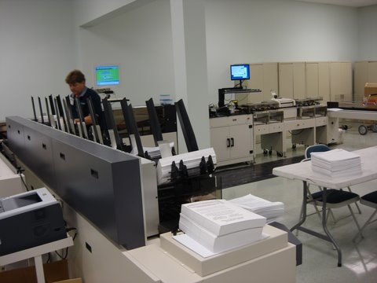
Relia-Vote
Absentee ballot processing

Slide 15

Topics for Discussion
Dr. Brenda C. Snipes Broward County Supervisor of Elections www.browardsoe.org
...WITH CONFIDENCE !
Election Process
Latest Election Statistics
2014 Election Dates
2014 Early Voting
Election Day Check-In
EViD Machine
Three Ways To Vote On Election Day

Slide 16

What Motivates You?

